Slide 1

Best City for
Each Yelp Category
Zhihang Yao (Evan)
Richard Pham
Jonathan Nguyen

Slide 2
Basic Idea
We wanted to find the best city for every Yelp category.
For example, we can find the city with the best hamburgers, bookstores, arcades, etc.
Notes:
As y’all can tell, the dataset we decided to go with for our capstone project is Yelp. Our goal for this project is to find the best city for every Yelp category in the United States. For example, we can find the city with the best hamburgers, bookstores, arcades, etc.

Slide 3




Technologies Used
Amazon EMR (Elastic MapReduce) & Hadoop clusters
Amazon S3: storage for input/output files
Google Colab: code sharing
Google Docs: planning
Discord: communication
Notes:
Here are all the technologies we used for our project. We used Amazon Elastic MapReduce with Hadoop to run our mapreduce program. In order to use Amazon EMR, we also needed Amazon S3 since EMR processes data stored in the S3 bucket. Adding on, Amazon s3 allowed us to store our dataset, code, and output files. In addition, we used Google Colab to share and write code, Google docs to write and plan our pseudocode, and Discord to communicate.

Slide 4
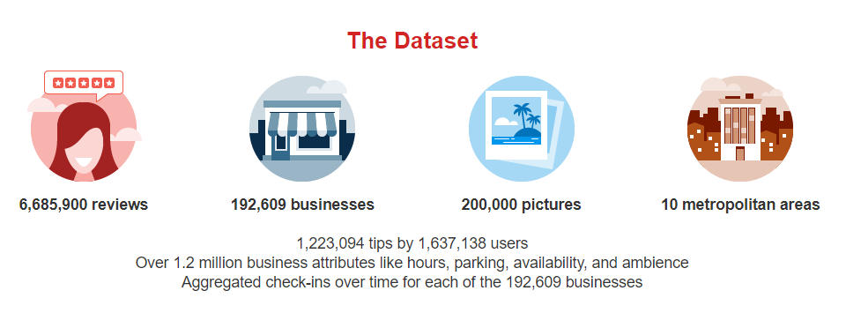
Dataset
We used the Yelp dataset, which is 8 GBs uncompressed.
dataset is comprised of multiple JSON files, with each file representing many JSON objects
E.g. business.json, reviews.json, user.json, checkin.json, tip.json, photo.json
We primarily used business.json and review.json
Notes:
The Yelp Dataset is around 8GBs uncompressed. In the dataset, there are multiple JSON files such as user.json, checkin.json, tip.json and more. Since we are focusing on finding the best city for each yelp category, we will be primarily using business.json and review.json. Business.json will give us access to each business id and their categories. Review.json contains every review written for each business.

Slide 5
Terminology
“good business”: 50+ reviews, 4 star+ average
“best city”: most number of good businesses in the city
Notes:
Here are some helpful terminology that we used as benchmarks for us to filter out substandard establishments . We defined a good business as an establishment with over 50 or more reviews and an average of 4 or more stars. We defined best city as a city with the most number of good business in that city.

Slide 6
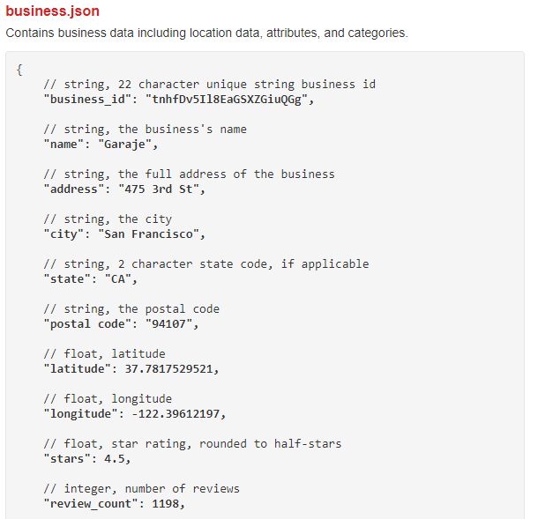
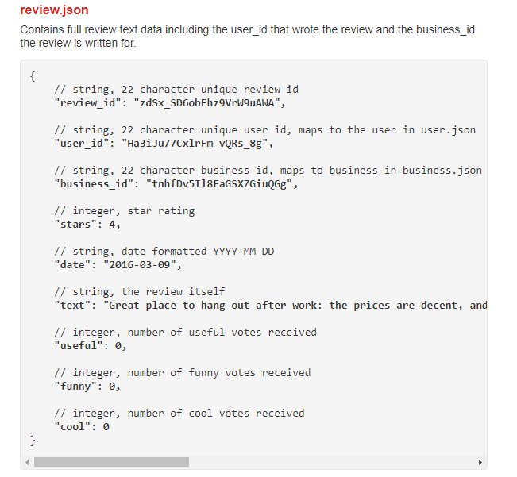
JSON files used

Slide 7
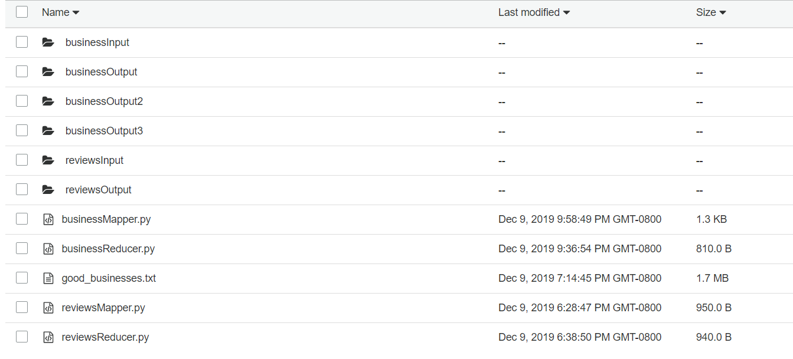
S3 Bucket

Slide 8
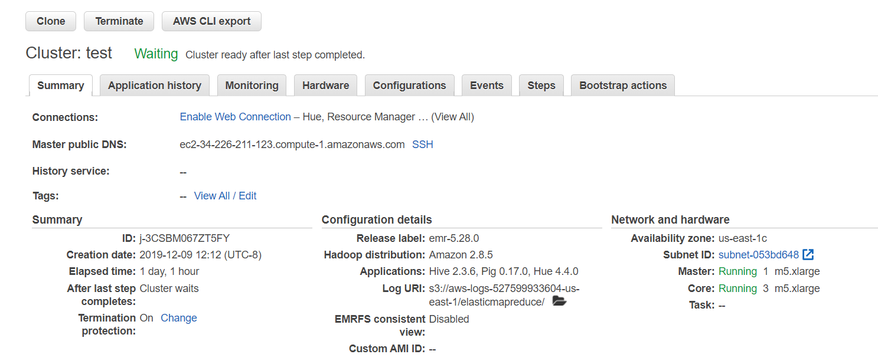
Hadoop Cluster

Slide 9
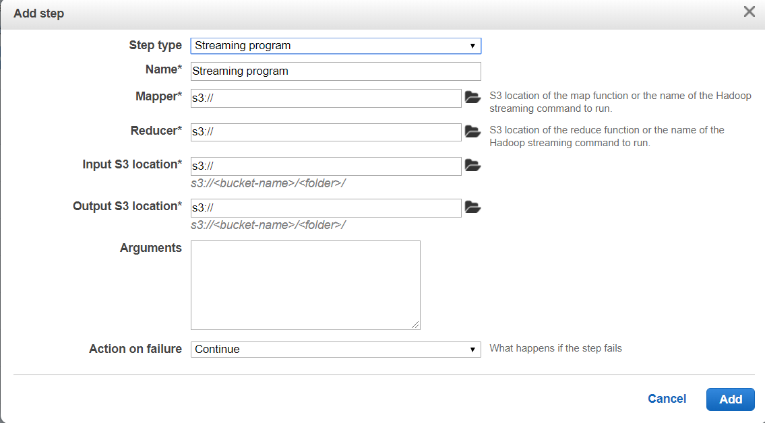
Running EMR

Slide 10
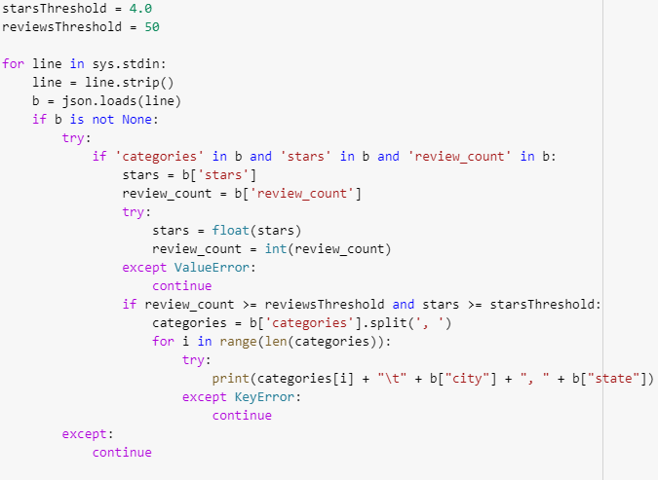
Mapper.py (business)

Slide 11
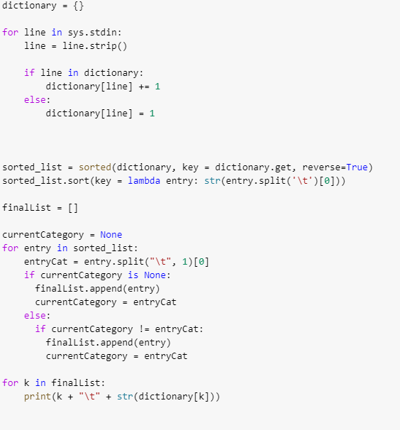
Reducer.py
(business)

Slide 12
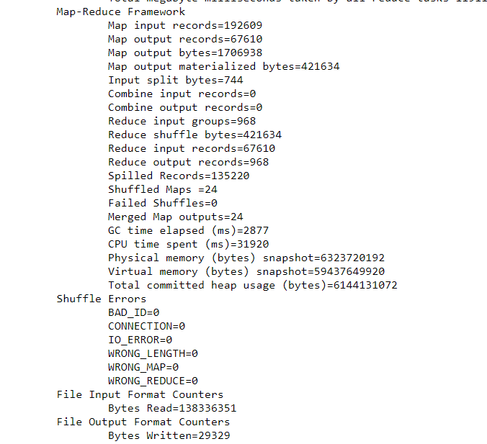
Syslog / Runtime
(business)
CPU runtime: about 32 sec.
Total runtime: 36 sec.

Slide 13
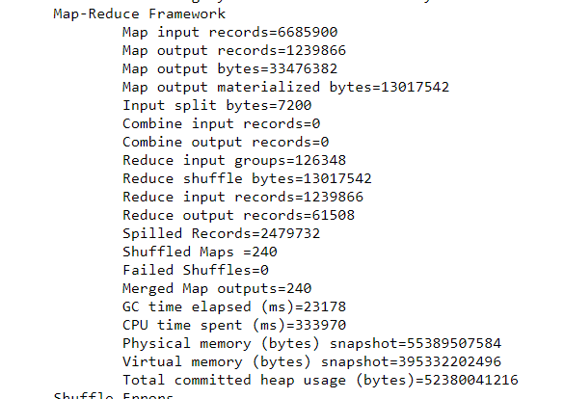
Syslog / Runtime
(review)
CPU runtime: about 5.5 mins.
Total runtime: about 6 mins.

Slide 14
Results (business)
Output is saved as a .txt file
Each line holds the category, city, state, and the number of good businesses in that location

Slide 15
Challenges Faced
Accuracy of the data is hard to verify because categories can be updated by both Yelp users as well as the business owners.
Some restaurants did not include a category, thus they are unaccounted for
Sorting our results by both popularity and category, and then retrieving the best category in each city
Utilizing Windows causes CR+LF per new line, thus we had to delete all CR every time we edit
Difficult to debug due to AWS EMR’s output. We had to debug using stderr and syslog.
We learned that we cannot import a local file when running EMR.

Slide 16
Questions?

